Slide 1

ASSET MANAGEMENT SYSTEM
Team Number: 5
Mentor Name: N. KATHIRESAN

Slide 2
TEAM MEMBERS…
SHWETA TRIPATHI
VINAYAK KEDIA
SAYANTANI BANERJEE
RAHUL MUKHERJEE
PRANJALI GUPTA
ROHIT KHANDAGALE
SNEHAL BAGADE

Slide 3
OBJECTIVES…
PROJECT ANALYSIS
Functional components of the project
DIAGRAMS
MODULES

Slide 4
PROJECT ANALYSIS
The project aims at developing an Asset Management System used for maintenance of asset details in an organization which can be accessed throughout the organization.
This is an integrated system that contains the Admin component and the User (Manager) component.

Slide 5
Approach used :
Front End & Web Components:–
HTML/JavaScript
Servlets
JSP
jQuery
Spring 4.0
Business Logic Components and Services :-
Java Beans
Application Servers :-
WildFly 8.0
Databases:-
Oracle SQL Developer
Notes:
Add the notes here.
Add instructor notes here.

Slide 6
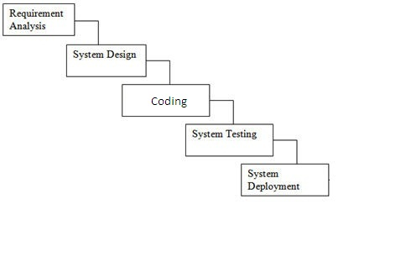
SDLC Model: Waterfall Model

Slide 7
FUNCTIONAL COMPONENTS…
There are two categories of people who would access the system viz. User (Manager) & Admin:
Managers are able to:
Login to the system using his/her credentials
Raise a request for allocation of asset to an employee, by filling up the asset requisition form that auto generates the asset request ID.
View the status of requests made by manager by entering his manager Id.
Administrator is able to:
Login into the system using his/her credentials
Include new asset/modify asset details from the inventory.
Approve/Reject a request on the basis of the details of the request raised. If raised request is approved, then allocate asset to an employee and change request status as ‘Approved’ else ‘Rejected’.

Slide 8
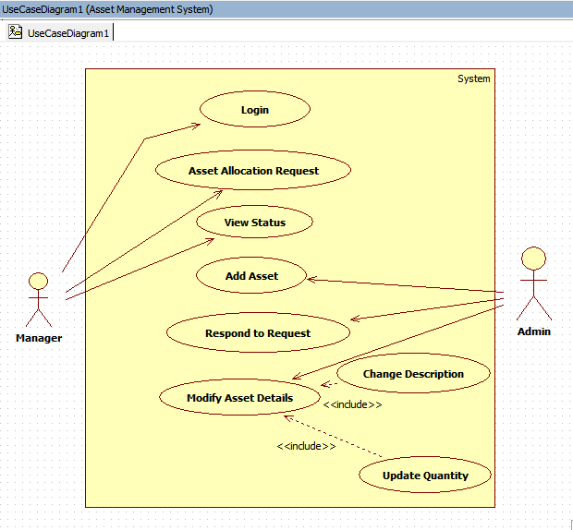
USE CASE DIAGRAM:
Capgemini Public

Slide 9
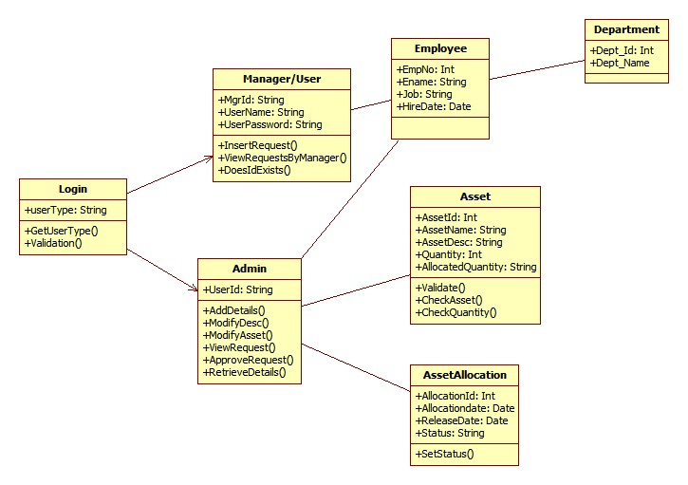
CLASS DIAGRAM:
Capgemini Public

Slide 10
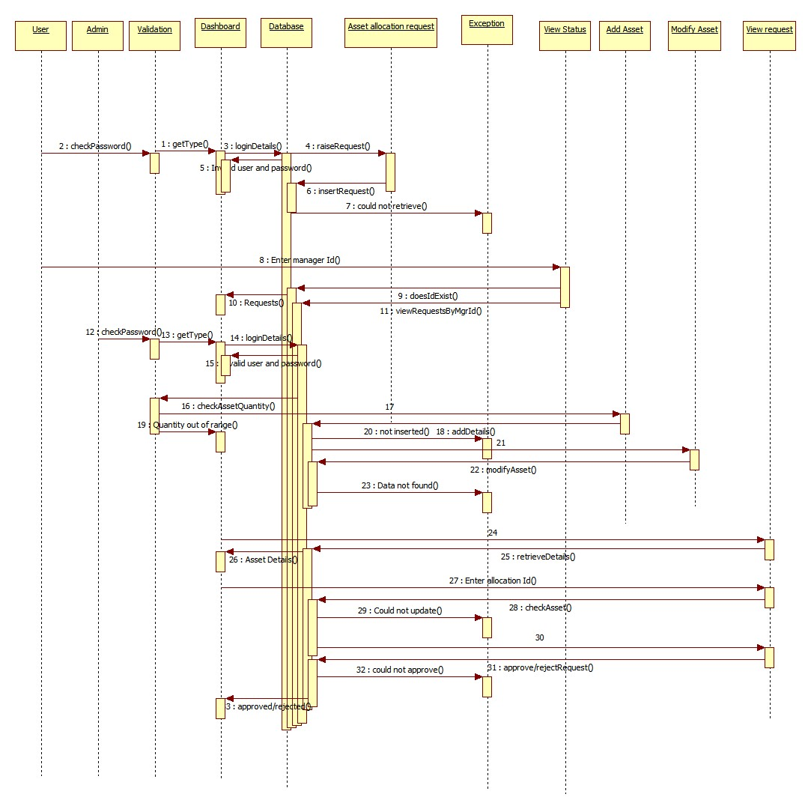
SEQUENCE DIAGRAM:
Capgemini Public

Slide 11
MODULES
Login
Raise A Request
Insert Raised Request
View Status
Add Asset
Modify Asset Details
Approve/Reject Request

Slide 12
MODULES(contd.)
I. LOGIN:
Login module is common for all the users of the system
i.e. Admin and User(Manager).
Basic functionalities of the login module are as follows:
Taking login credentials from the user.
If given credentials are wrong, show appropriate message.
If login succeeds, user will be navigated to his/her respective page as per his/her role.

Slide 13
MODULES(contd.)
Raise A Request:
This module is for the Manager to raise a request for required asset.
Basic functionalities of the Raise A Request module are as follows:
Raise a request on behalf of Employee.
Automatically generated allocation Id is displayed.

Slide 14
MODULES(contd.)
Insert Raised Request:
This module is for the Manager to insert a request for required asset.
Basic functionalities of the Insert the Raised Request module are as follows:
Insert the raised request into the database.

Slide 15
MODULES(contd.)
IV. View Status:
This module is for the Manager to view status of requests.
Basic functionalities of the View Status module are as follows:
View status of the Request raised by the manager himself.

Slide 16
MODULES(contd.)
V. Add Asset:
Add Asset module is for the Admin to add new asset into the database.
Basic functionalities of the Add Asset module are as follows:
Admin can insert new asset into database.

Slide 17
MODULES(contd.)
VI. Modify Asset Details:
Modify Asset Details module is for the Admin to modify the asset details into the database.
Basic functionalities of the Modify Asset Details module is as follows:
Admin can update the details of the asset according to the requirements. He can change the description of asset and increase or decrease the quantity of asset.

Slide 18
MODULES(contd.)
V. View Request:
View Request module is for the Admin to view, approve/reject the raised request.
Basic functionalities of the View Request module are as follows:
Admin can view the raised requests.
Admin can approve or reject the raised requests.

Slide 19
Learning
1.Technical Learning:
It lead to learning , implementing and improving the skills related to technical fields such as java 8.0,Spring 4.0,JSP-Servlets.
As we know that theory unless implemented practically is of no use, so doing such projects also helps in furnishing the technical skills and to work on our weak areas.

Slide 20
Learning(contd..)
2.Non-TechnicalLearning:
It lead to development of several traits that lead to development of skills as:
Work in time constraint : It taught us to work for a project/task in a time constraint i.e. to define and schedule our tasks according to time constraint, how to divide the task, etc.
Team work: It taught us to work in a team efficiently , communicate with team members efficiently as well as to understand each others aspect efficiently.

Slide 21
Best Practices
Since Spring 4.0 is used so annotations are used which reduce the compilation errors.
The variables are initialized before they are used.
The for each loop is used for iteration purpose .
The proper naming conventions are used.
No Deprecated Method is used.
Use the indentation to show the logical structure of the program.
Notes:
Add the notes here.
Add instructor notes here.

Slide 22
Thank You
Capgemini Public

